Slide 1
Lecture 1: Introduction to Physical Design
Tsung-Wei (TW) Huang
Department of Electrical and Computer Engineering
University of Utah, Salt Lake City, UT

Slide 2
Logistics
Instructor: Dr. Tsung-Wei Huang (TW)
tsung-wei.huang@utah.edu
MEB 2124
Time: MoWe / 3 PM – 4:20 PM (excluding holidays)
In person: WEB L114
Zoom (back-up plan): https://utah.zoom.us/j/2468214418
Webpage
GitHub: https://github.com/tsung-wei-huang/ece5960-physical-design/
Office hour: by appointment

Slide 3
Scoring
Total 100 points
Four programming assignments of key physical design algorithms
Class presentation for each programming assignment
Academic integrity
I trust you but don’t take it for granted (it’s your career not mine…)
https://regulations.utah.edu/academics/6-400.php
Textbook
No need to buy any textbook
Slides will be available and are enough

Slide 4
Class Philosophy
Learn important physical design algorithms
Combinatorial optimization problems (e.g., graph, discrete math)
Analytical methods (e.g., linear programming)
Program important physical design algorithms
Write C/C++/Python code to solve physical design problems
Implement various data structures and algorithms
At the end of the class, I want you to
Understand important computer design problems
Improve your coding skills and algorithm knowledge
Have more job opportunities in software companies (high pay today!)

Slide 5
Programming Machines
Linux programming environment
Utah CADE Linux machine: https://www.cade.utah.edu/
Your personal MacBook, Linux desktop, etc.
Evaluation environment
Instructor’s server: twhuang-server-01.ece.utah.edu
Email the instructor (tsung-wei.huang@utah.edu) for an account with
Your account name
Your default password
Programming languages
No restriction but highly recommend C/C++

Slide 6
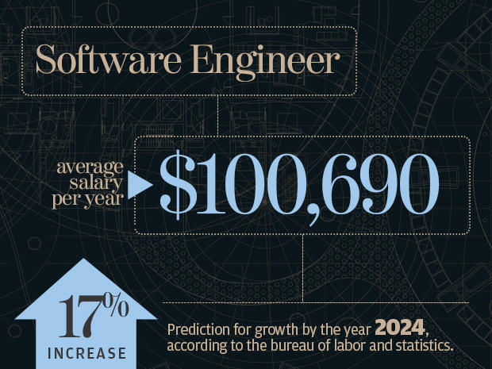
Why Programming…?

Slide 7

What Language?

Slide 8
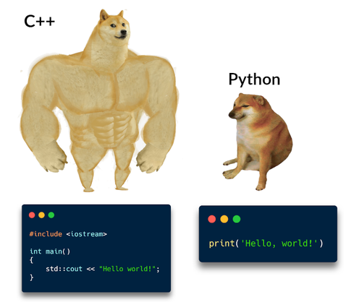
From my 10-year Programming Perspective
In general, your logic thinking matters the most
How to formulate a problem computationally?
How to solve a computational problem efficiently?
How to improve the solution quality programmatically?
However, as a CE/CS student, I highly recommend
C/C++ let you know how performance works
Python let you know how productivity works
Java let you know how portability works

Slide 9
Silicon Compiler (Design Automation)
Hardware description (Verilog/VHDL)
Logic synthesis
Front end
Netlist (gate-level description)
Physical design
Back end
Layout (GDSII)

Slide 10
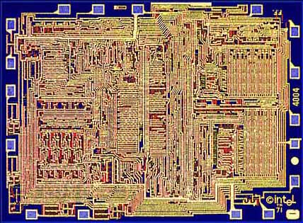
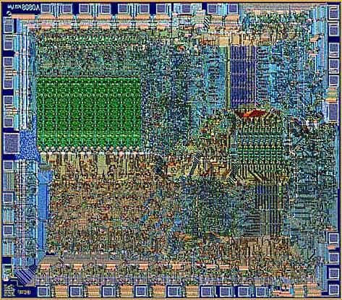
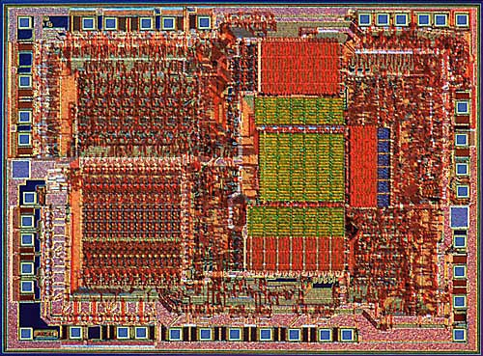
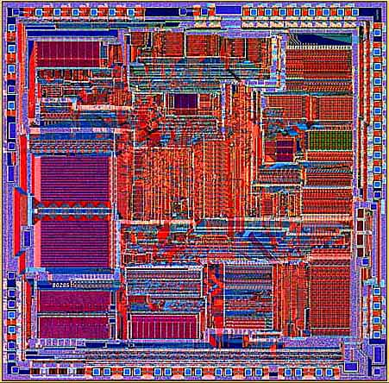
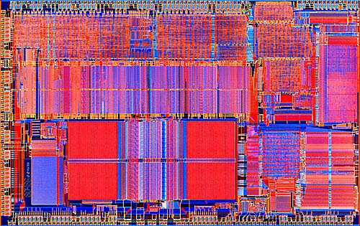
Why Silicon Compiler?
Intel 4004 (‘71)
Intel 8080
Intel 8085
Intel 8286
Intel 8486

Slide 11
Silicon Compiler: Front-end
System Specification
Functional Design
X=(AB*CD)+(A+D)+(A(B+C))
Y=(A(B+C))+AC+D+A(BC+D))
Logic Design
Circuit Design

Slide 12
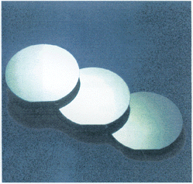
Silicon Compiler: Back-end
Physical Design
Fabrication
Packaging

Slide 13

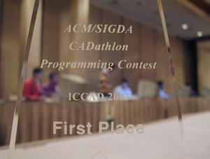



Physical Design Flow
Large amount of research opportunities!

Slide 14
Complexity of Physical Design
More than 100 million transistors
Performance driven designs
Power-constrained designs
Time-to-Market
Design cycle
……
High performance, high cost

Slide 15
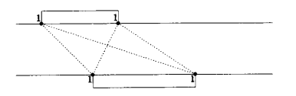
History of Physical Design
Born in early 60’s (board layout)
Passed teenage in 70’s (standard cell place and route)
Entered early adulthood in 80’s (over-the-cell routing)
Declared dead in late 80’s !!!
Found alive and kicking in 90’s
Physical Design has become a key force in design cycle
Thanks to the deep submicron scaling! We really need automation!
Thanks to algorithm innovations in computer science
Thanks to computer hardware advancement

Slide 16
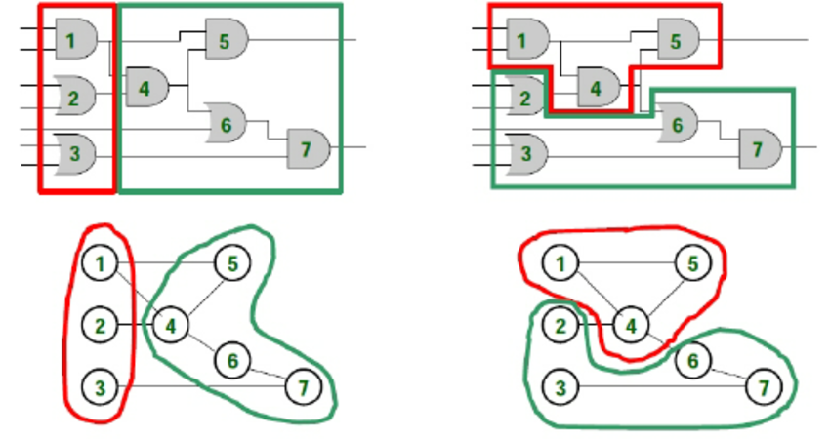
Circuit Partition Example
Which partition result is better?

Slide 17
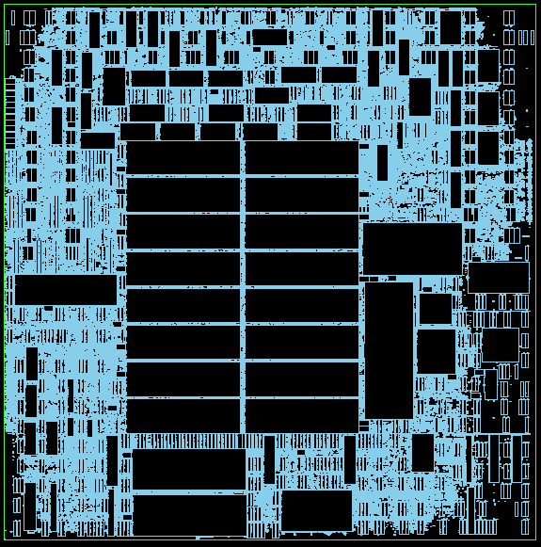
Floorplan Example
Many macros
Data paths + logic elements
I/O constraints
Area
Wire bond
Connection (e.g., gate 1 links gate 2)
…

Slide 18
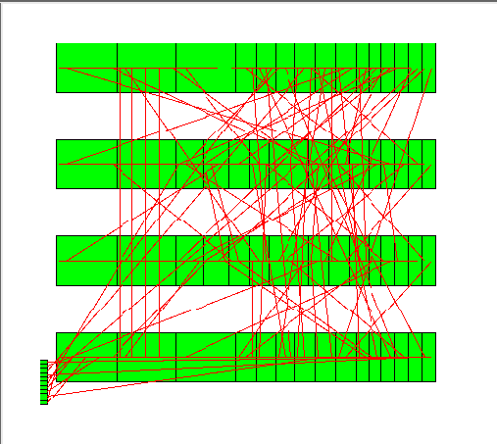
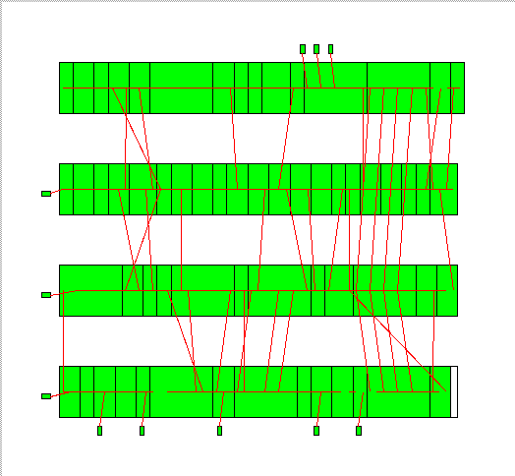
Placement Example
Which placement result is better?

Slide 19
Placement Example (cont’d)
Commercial tools are still away from optimal solutions …

Slide 20
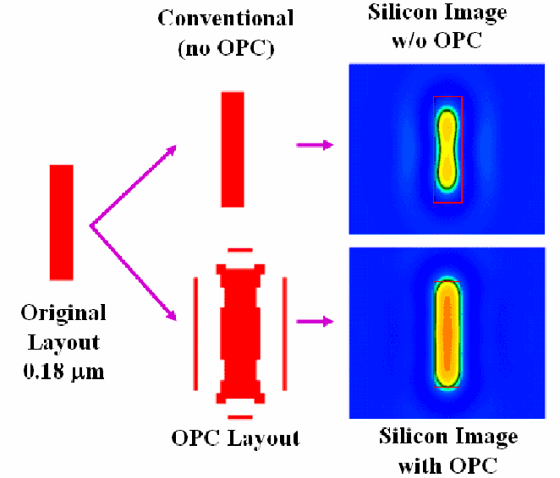
Lithography Example

Slide 21
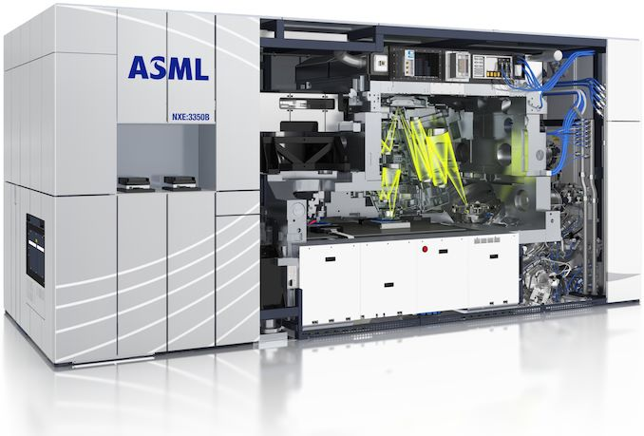
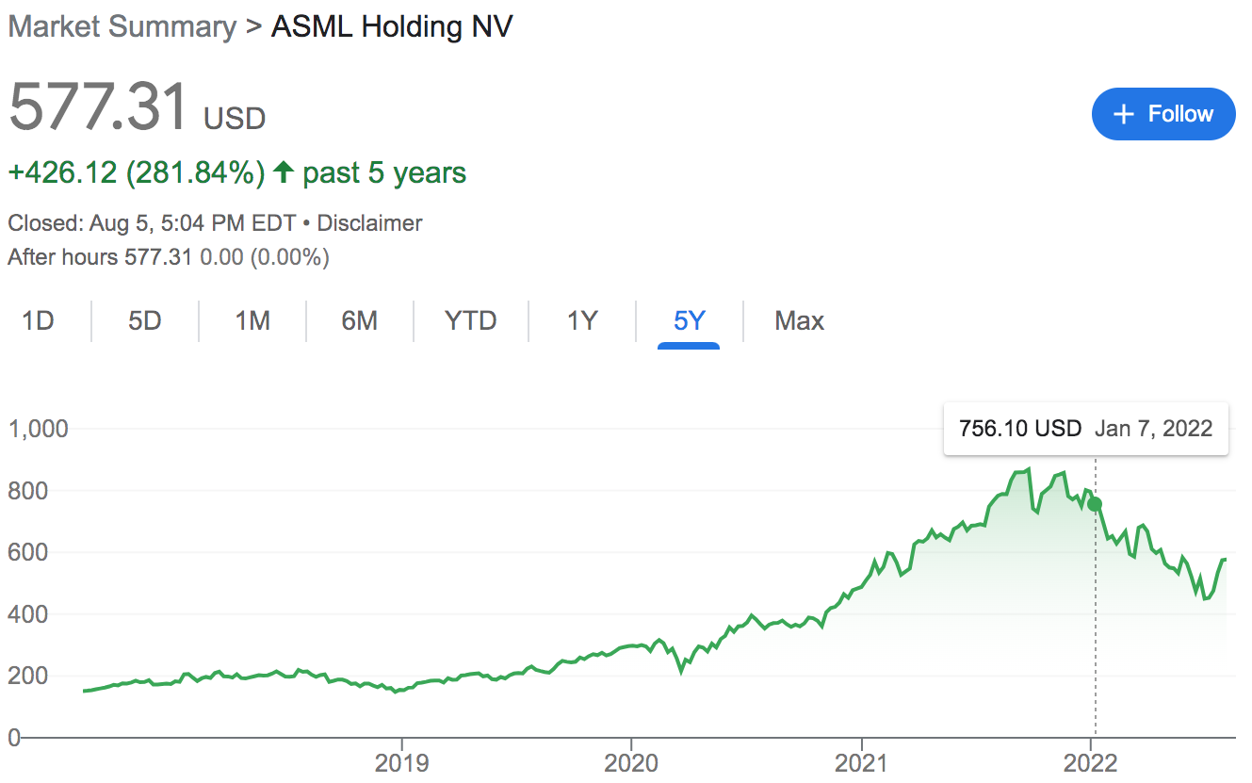
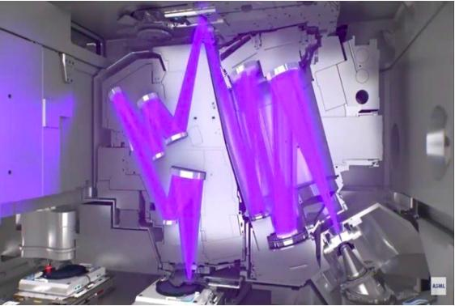
Lithography Example (cont’d)

Slide 22
Optical Proximity Correction (OPC)
More OPC friendly

Slide 23
We Need Algorithms!
To optimize design among different objectives, area, power, performance, and etc.
Fundamental questions: How to do it smartly?
Definition of algorithm in a board sense: A step-by-step procedure for solving a problem. Examples:
Cooking a dish
Making a phone call
Sorting a hand of cards
Definition for computational problem
A well-defined computational procedure that takes some value as input and produces some value as output

Slide 24
Computational Problems
Decision problem
Given a positive integer n, determine if n is prime
Search problem
Find all even numbers in X=[1,2,3,4,5]
Counting problem
Given a positive integer n, count its number of nontrivial prime factors
Optimization problem
Given a graph G, find an independent set of G of maximum size
…
How do we solve these problems smartly?

Slide 25
Example: Big Mod Problem
Computational problem description
Input: a, b, c (3<a, c<5000000, 1<b<2147483647)
Output: x = a^{b} (mod c)
A simple solution
for(i=1, x=1; i<=b; i++)
x = (x*a)%c;
std::cout << “a^b % c = ” << x << std::endl;
Is the solution smart enough?

Slide 26
Example: Big Mod Problem
Computational problem description
Input: a, b, c (3<a, c<5000000, 1<b<2147483647)
Output: x = a^{b} (mod c)
A simple solution
for(i=1, x=1; i<=b; i++)
x = (x*a)%c;
std::cout << “a^b % c = ” << x << std::endl;
Is the solution smart enough?
We need a total of “b” iterations
Very slow execution for large b

Slide 27
Refined Solution (Recursive)
#define SQUARE(x) (x*x)
int bigmod(int a, int b, int c) {
if(b==0) return 1;
else if(b%2==0)
return SQUARE(bigmod(a,b/2,c)%c)%c;
else return ((a%c)*bigmod(a,b-1,c))%c;
}
int main() {
int a,b,c;
while(std::cin >> a >> b >> c) std::cout<<bigmod(a,b,c)<<endl;
return 0;
}
2¹⁶ = ( 2⁸ )² total 1 calculation
2⁸ = ( 2⁴ )² total 1 calculation
2⁴ = ( 2² )² total 1 calculation
2² = ( 2¹ )² total 1 calculation
2¹ = ( 2⁰ ) total 1 calculation

Slide 28
Refined Solution (Iterative)
int bigmod(int a, int b, int c) {
int result = 1;
while(b > 0) {
if(b & 1) {
result = (result * a) % c;
}
b = b >> 1;
a = a*a%c;
}
return result;
}

Slide 29
Runtime Comparison
https://www.onlinegdb.com/
Runtime (with –O2) – Enabled Optimization
(a, b, c) | Naive | Refined (recursive) | Refined (iterative)
(2, 1000000, 3) | 13720 us | 24 us | 22 us
(2, 10000000, 3) | 136148 us | 9 us | 4 us
(2, 100000000, 3) | 1320049 us | 8 us | 4 us

Slide 30
Code Analysis
https://godbolt.org/z/6zT4cK3Wz
 | Naive | Refined (recursive) | Refined (iterative)
Lines of C++ Code | 7 | 11 | 11
Lines of Assembly (-O0) | 55 | 99 | 59
Lines of Assembly (-O2) | 27 | 57 | 32

Slide 31
Magic behind the Refined Solution
In fact, there is a name for the refined method:
Divide and Conquer (D&C) algorithm
(used to solve >50% large and complex computational problems, e.g., Google Map, sorting, etc.)

Slide 32
D&C is Widely used in Physical Design
Modern circuits sizes are too large to handle in a flat fashion
42M transistors
1.5MHz; 224 mm²
Directly solving the original problem takes forever to finish …
Notes:
Like I said, Divide and Conquer is heavily used in CAD. Modern circuit sizes are just too large to handle in flat. If you do this, it means billions of transistors at one time. You have no hope to finish it in a reaonsable amount of time. To give you a sense on the size, when I was working in IBM ....( explore )

Slide 33
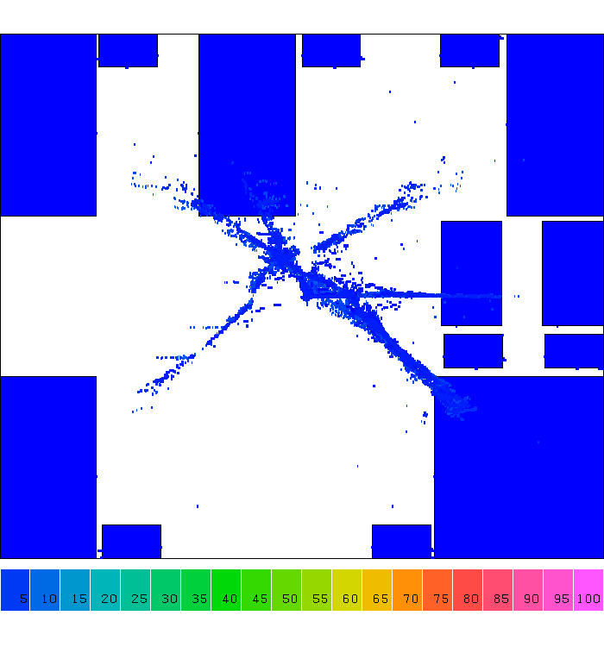
Example: D&C-based Placement
Notes:
Let's take a look at one step of computer design, placement. A placement is a step that tries to find the location of each gate, you know Or gate, NAND gate, NOT gate, and other gates, in a chip area. And we have billions of gate to place in a finger size chip.
Computer design tools don't do this. They do this in divide and conquer. (explain)

Slide 34
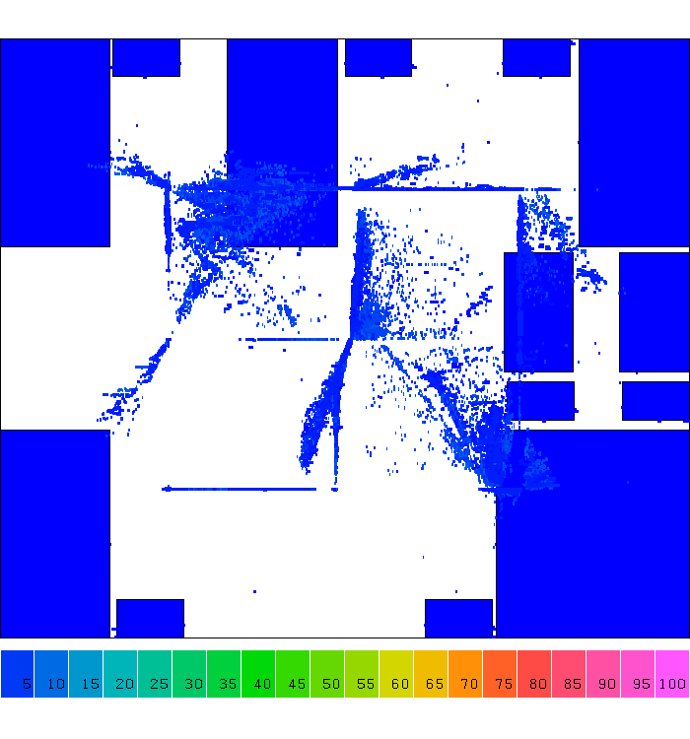
Example: D&C-based Placement

Slide 35
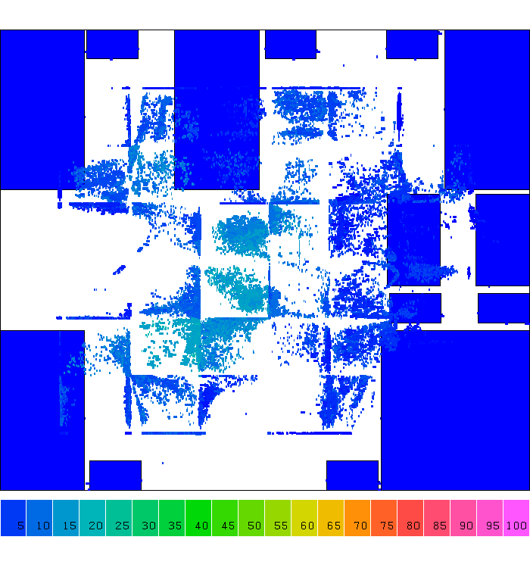
Example: D&C-based Placement

Slide 36
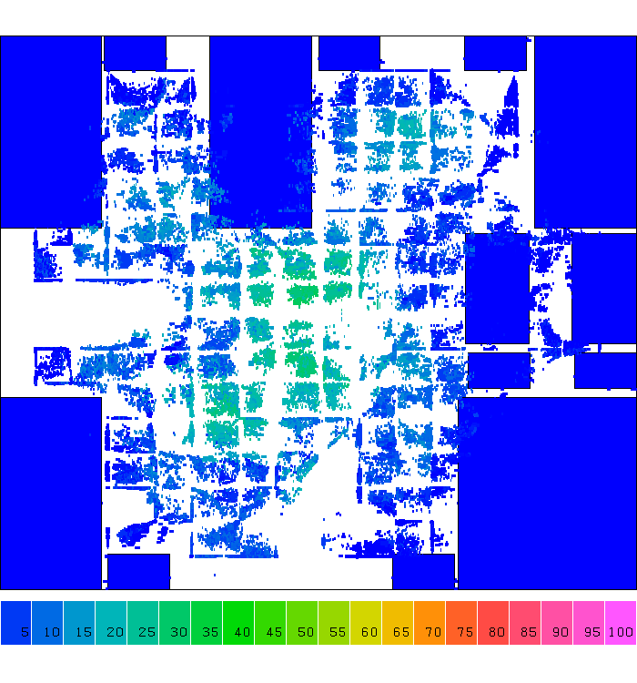
Example: D&C-based Placement

Slide 37
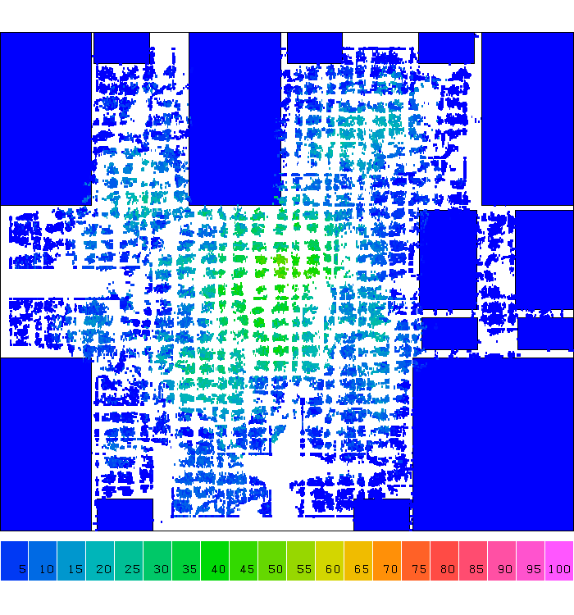
Example: D&C-based Placement

Slide 38
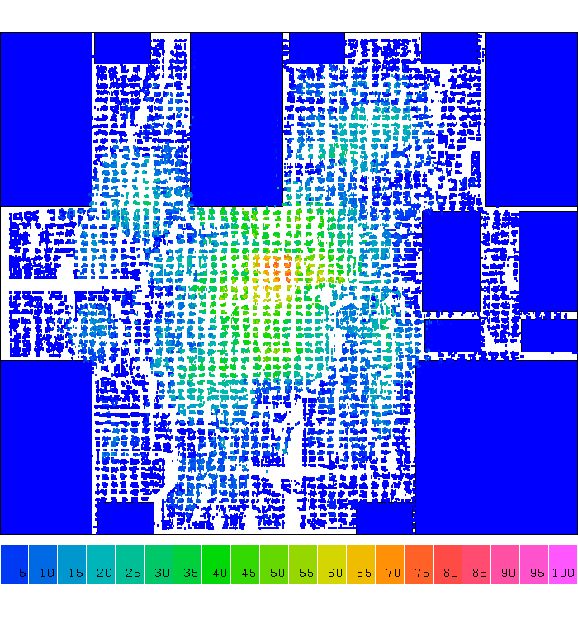
Example: D&C-based Placement

Slide 39
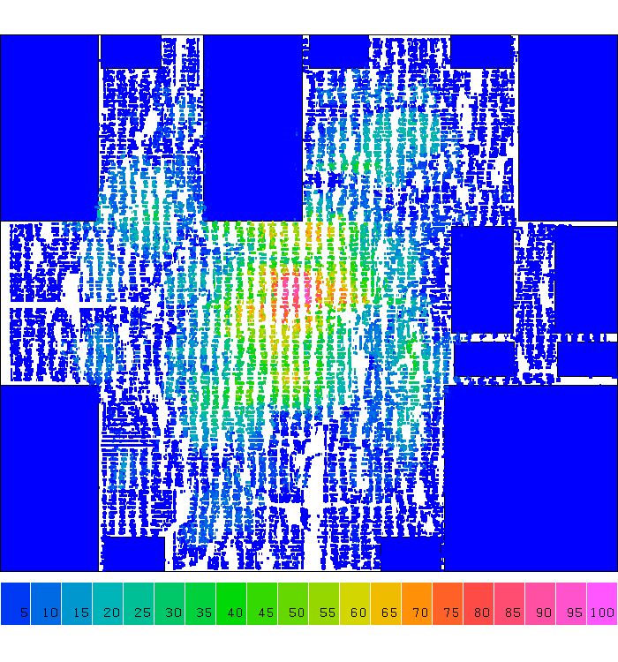
Example: D&C-based Placement

Slide 40
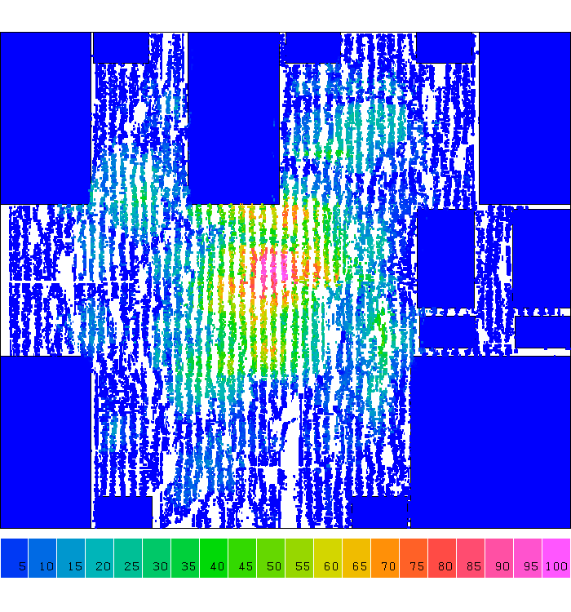
Example: D&C-based Placement
Notes:
So, from iteration to iteration you can clearly see cells are placed very regularly, right, Cells are spreading along the 2D grid partition. We partition the large chip care into smaller grids and place cells in those small grids. Solving the smaller grid problem is definitely more efficiently than directly handling the original problem.

Slide 41
Summary
We have discussed class logistics
We have discussed design automation flow
We have discussed physical design
We have discussed concept of computational problems
We have discussed a computational problem example
Problem formulation
Naïve solution
Refined solution
Practical code analysis techniques

